Slide 1
Remote Sensing Image Analysis

Slide 2
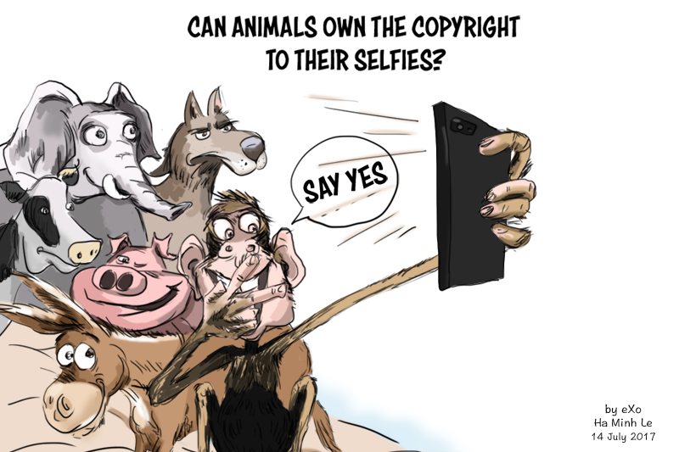
Remote + Sensing
How far is remote?

Slide 3
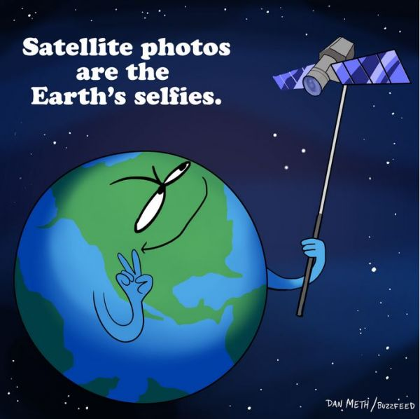
Remote + Sensing
How far is remote?

Slide 4
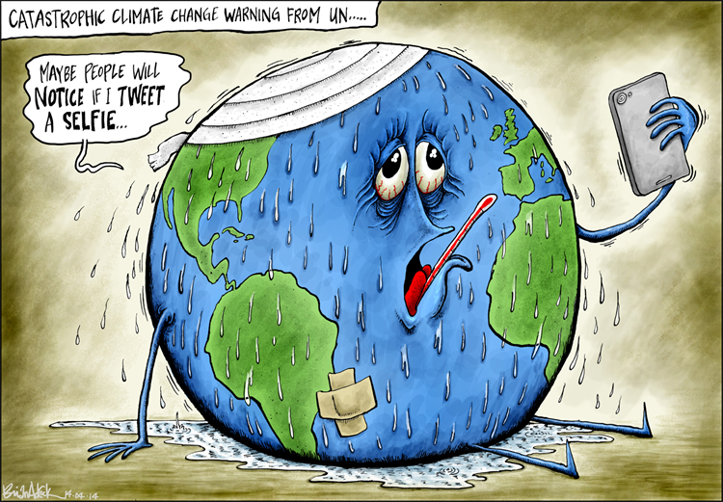
What do these sensors sense?
Atmospheric conditions
Weather
Composition
Earth surface
Forest
Agriculture
Settlement
Glacier
Source: https://www.cagle.com/brian-adcock/2014/04/earth-selfie

Slide 5
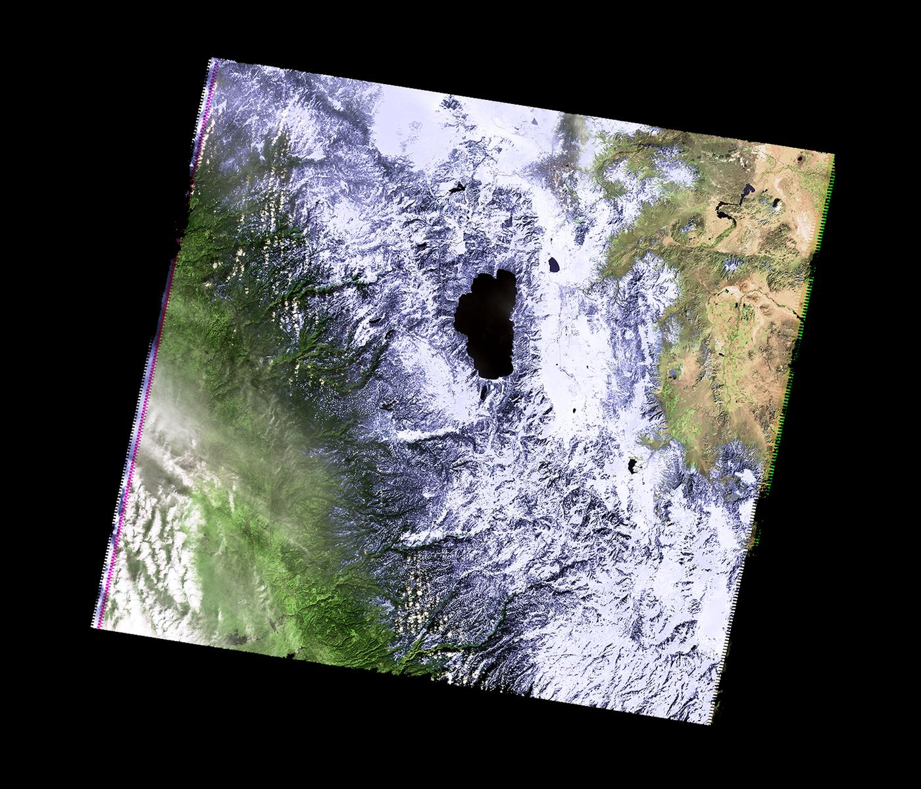
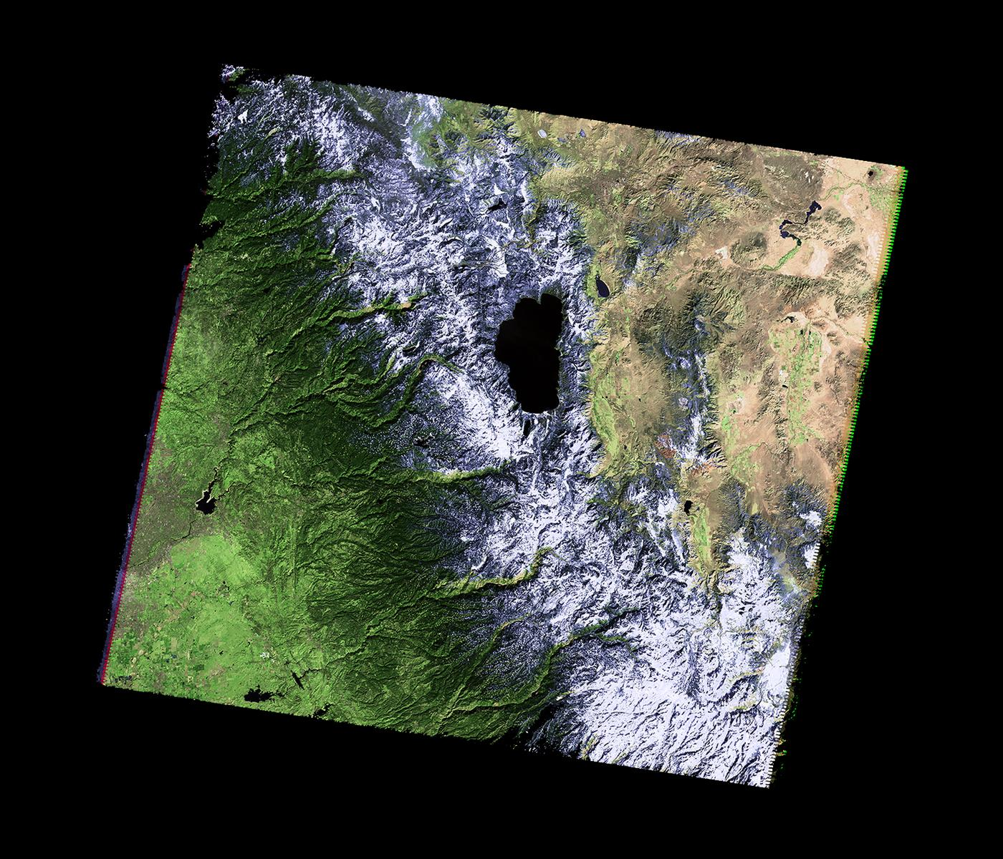
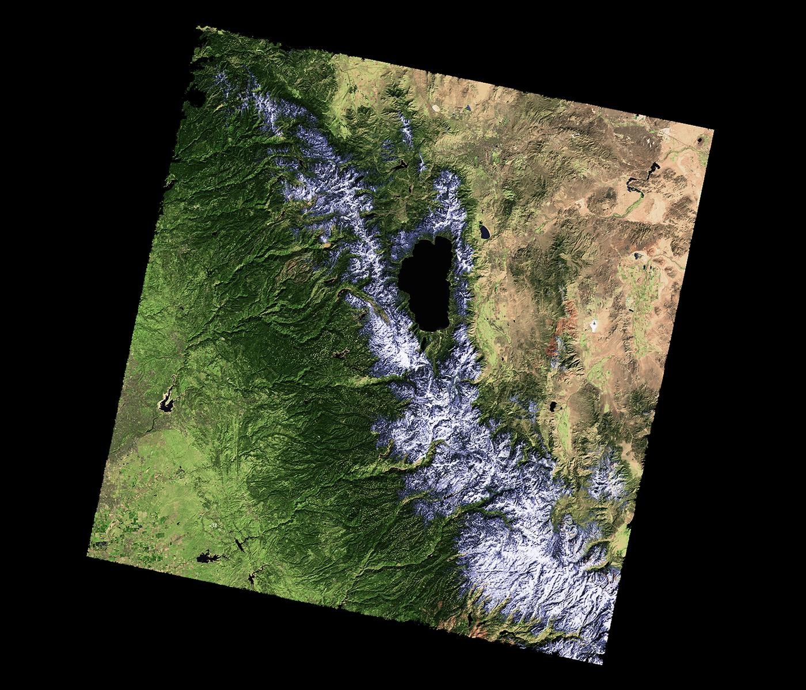
Monitoring
California Drought & Sierra Snowpack
Feb 2011
Feb 2013
Feb 2014
> landsat <- stack(‘LC08_042034_20140216.tif’)
> plotRGB(landsat, r = 4, g = 3, b = 2, stretch = "lin")
Source: USGS.

Slide 6
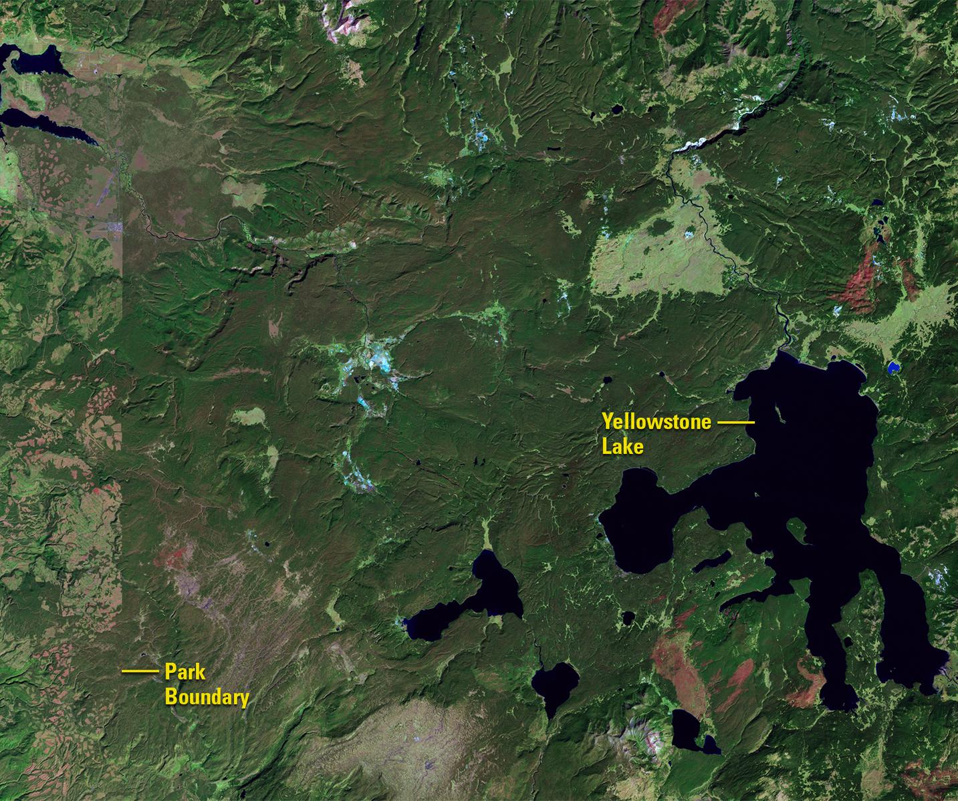
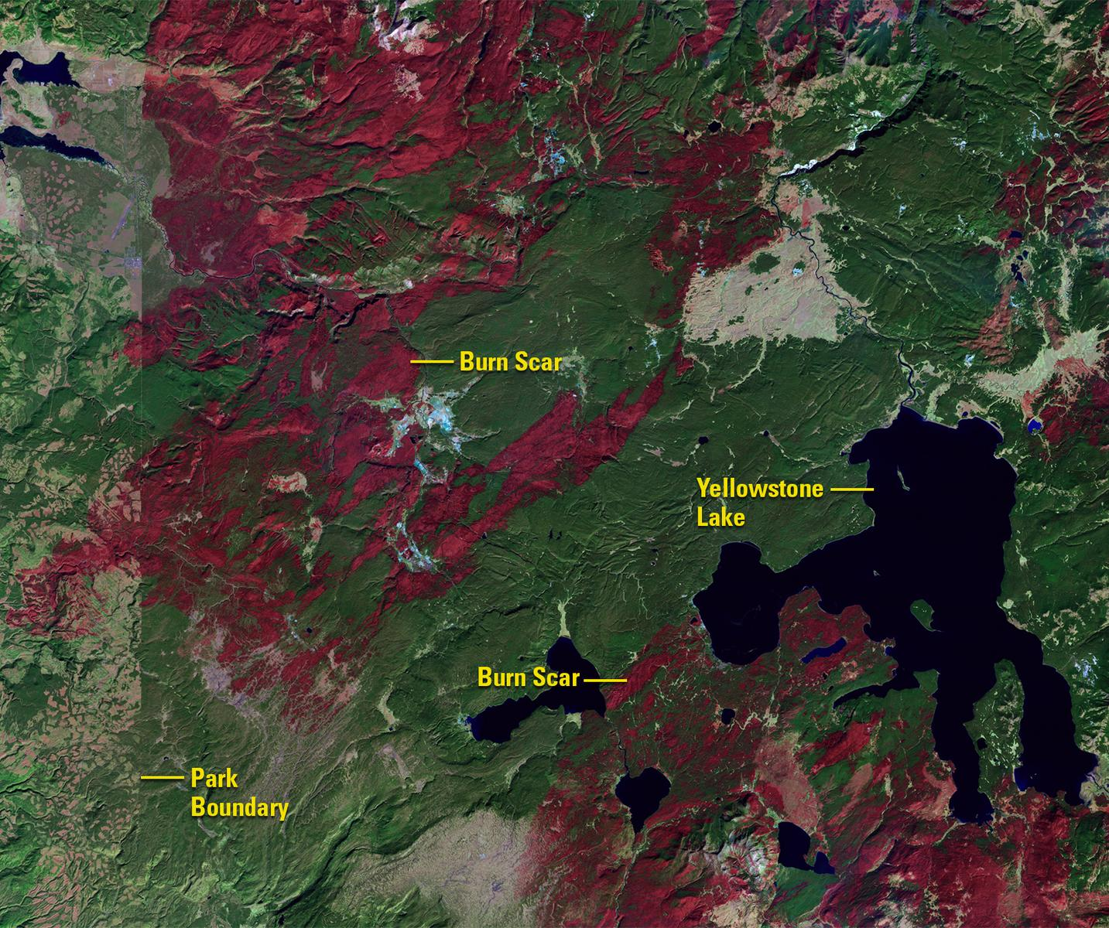
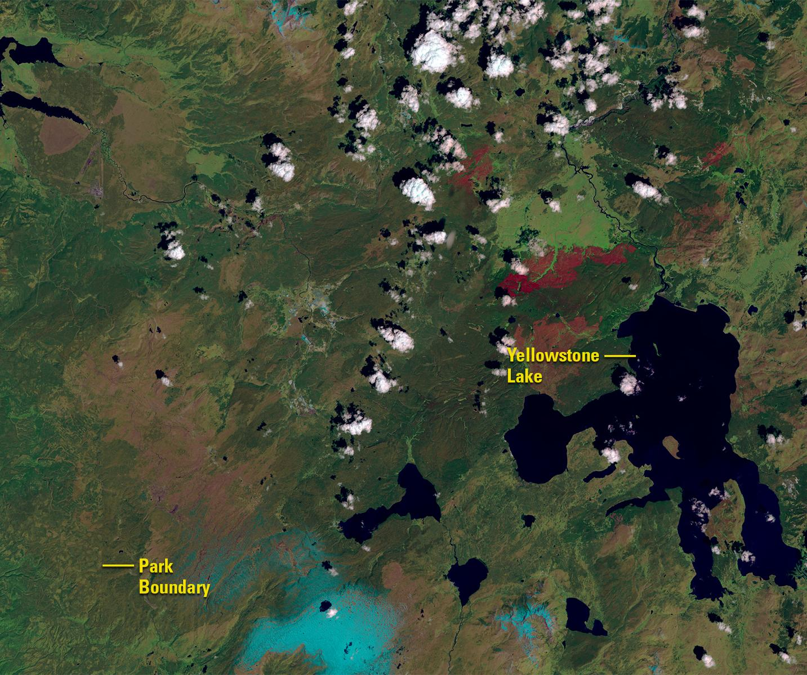
Monitoring
Wildfire (Yellowstone)
1987
1988
2016
Source: USGS.

Slide 7
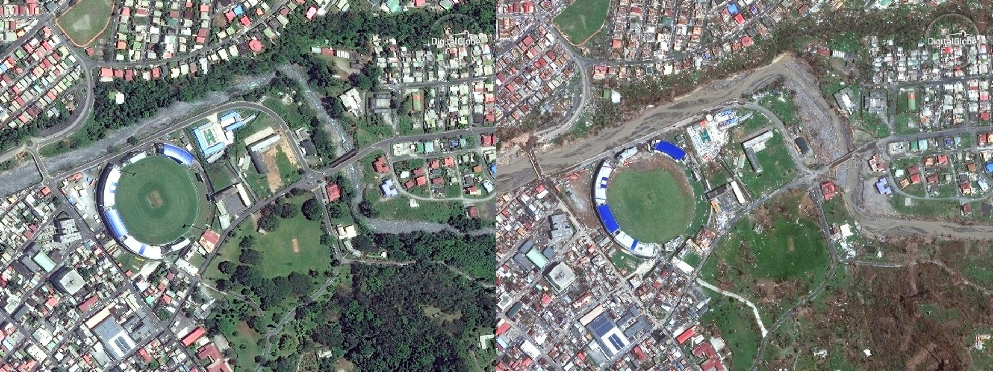
Filling Information Black Holes
Hurricane relief efforts
Roseau, Dominica captured by WorldView-2. Left Image: May 1, 2017, Right image September 22, 2017
Source: DigitalGlobe.

Slide 8
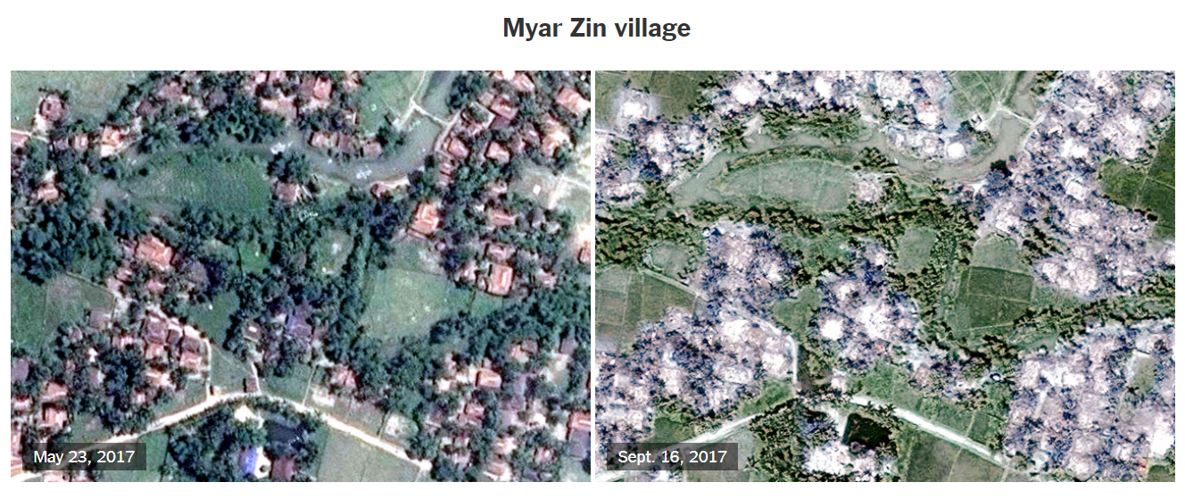
Filling Information Black Holes
Rohingya Villages Burning in Myanmar
Source: New York Times & DigitalGlobe

Slide 9
Understanding Global Changes
Amazon Deforestation
Aral Sea
Artificial Islands Dubai

Slide 10
Formal definition
“the art, science, and technology of obtaining reliable information about physical objects and the environment, through the process of recording, measuring and interpreting imagery and digital representations of energy patterns derived from noncontact sensor systems”.
ASPRS adopted a combined formal definition of photogrammetry and remote sensing as (Colwell, 1997)

Slide 11
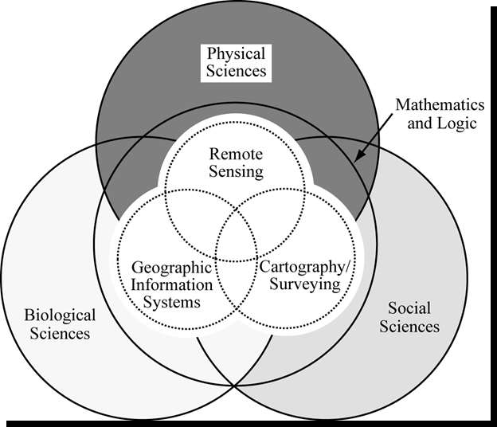
Interdisciplinary
Computer science, Statistics
Adapted from Jensen, ERP, 2006

Slide 12
Advantages
“Unobtrusive”: non-destructive measurement to record the energy reflected or emitted by the object of interest without disturbing the system
“Systematic and regular”: E.g. 10 sqm frame covered every 5 days (no sampling no bias introduced in some in situ investigations)

Slide 13
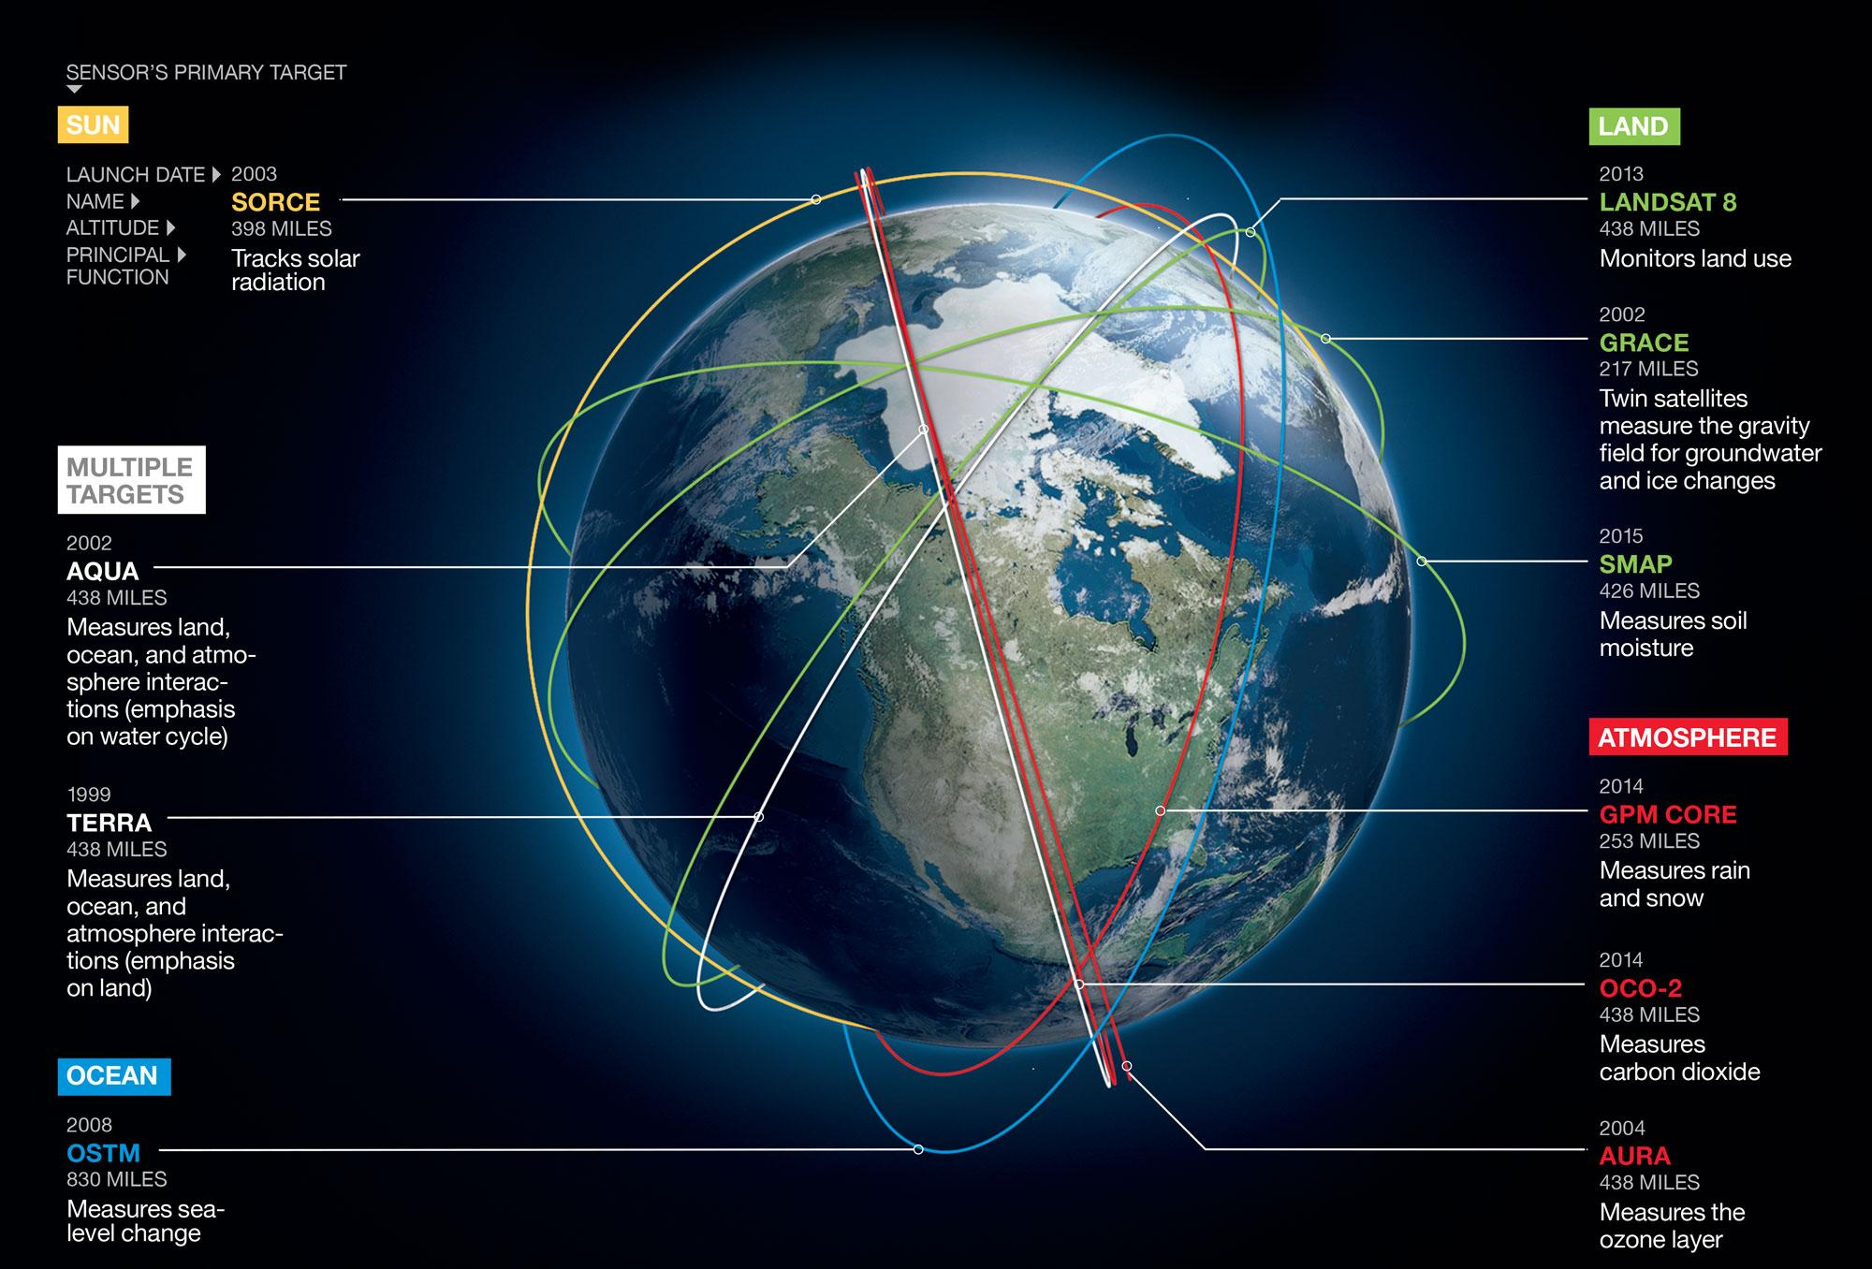
Different remote sensing platforms
Source: http://ngm.nationalgeographic.com/2015/11/climate-change/pulse-of-the-planet-text

Slide 14
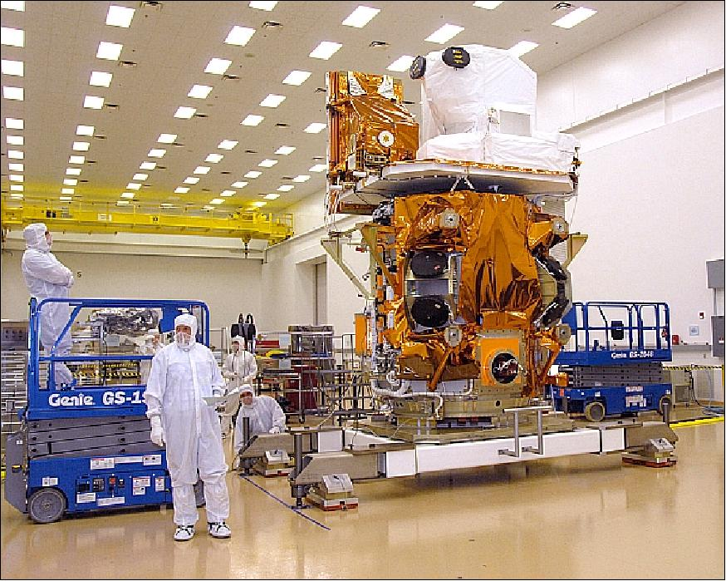
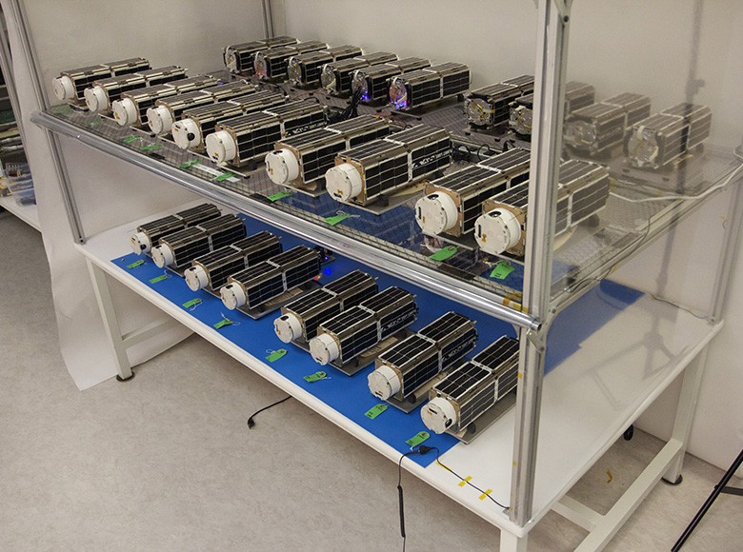
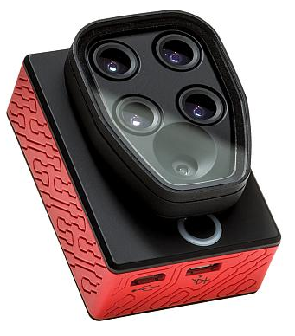
Sensors/ Cameras
Landsat 8 ~ 1500 kg,
855 million USD
Planet ‘dove’: 10 cm x 10 cm x 30 cm and a mass of ~ 5.8 kg,
Cost ~ X000 USD (?)
Parrot Sequoia:
59 mm x 41 mm x 18mm and a mass of ~ 72 gm,
Cost ~ 3000 USD
Source: https://directory.eoportal.org; https://support.micasense.com/ ; https://www.planet.com

Slide 15
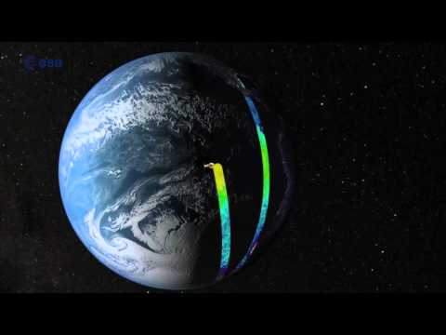
How
Remote Sensing satellites work
Source:
https://www.youtube.com/watch?time_continue=1&v=EnF_ljgk3gk

Slide 16
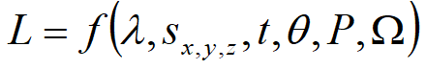
Pixel
wavelength (spectral response measured in various bands or at specific frequencies).
x, y, z location of the pixel and its size (x, y)
electromagnetic radiance, L (watts m-2 sr-1; watts per meter squared per steradian) recorded within the IFOV of an optical remote sensing system (pixel)
when and how often the information was acquired
radiometric resolution (precision) at which the data (e.g., reflected, emitted, or back-scattered radiation) are recorded
set of angles that describe the geometric relationships among the radiation source
polarization of back-scattered energy recorded by the sensor
Source: Adapted from Jensen, 2007

Slide 17
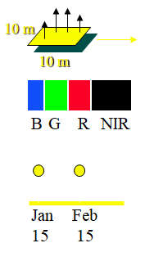
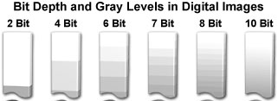
Spatial size of the field-of-view/ pixel, e.g. 10 x 10 m.
Spectral number and size of spectral regions the sensor records data in, e.g. blue, green, red, near-infrared thermal infrared, microwave (radar).
Temporal how often the sensor acquires data, e.g. every 30 days.
Radiometric sensitivity of detectors to small differences in electromagnetic energy.
Jensen, ERP, 2006

Slide 18
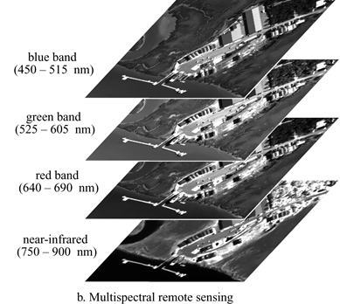
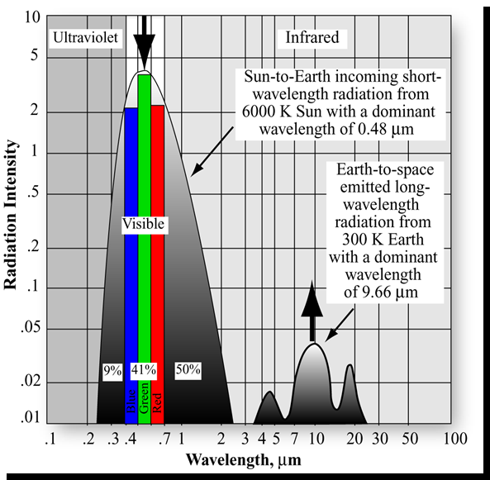
Spectral Resolution
Jensen, ERP, 2006

Slide 19
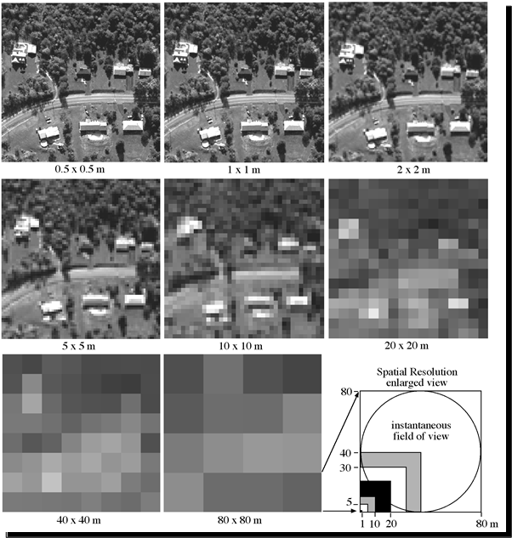
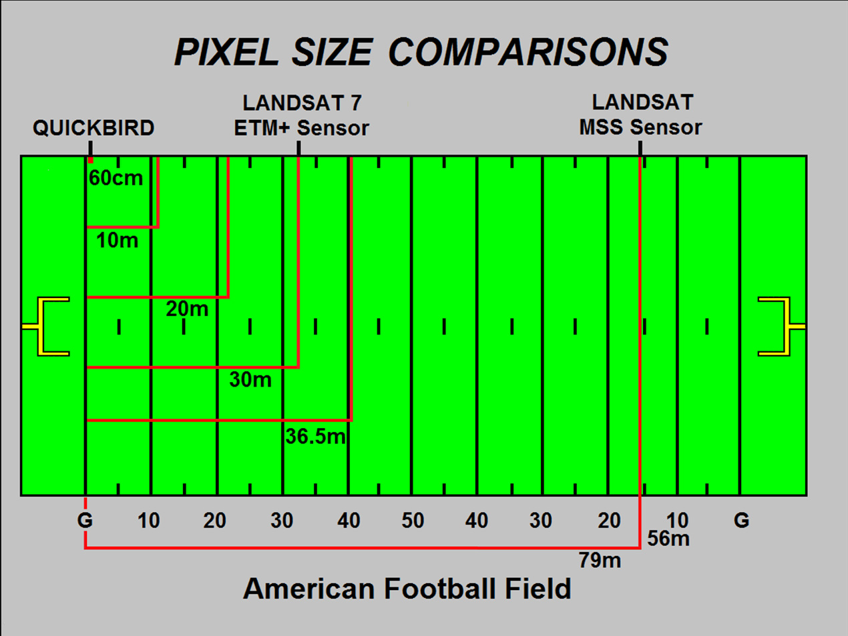
Spatial Resolution
Jensen, ERP, 2006

Slide 20
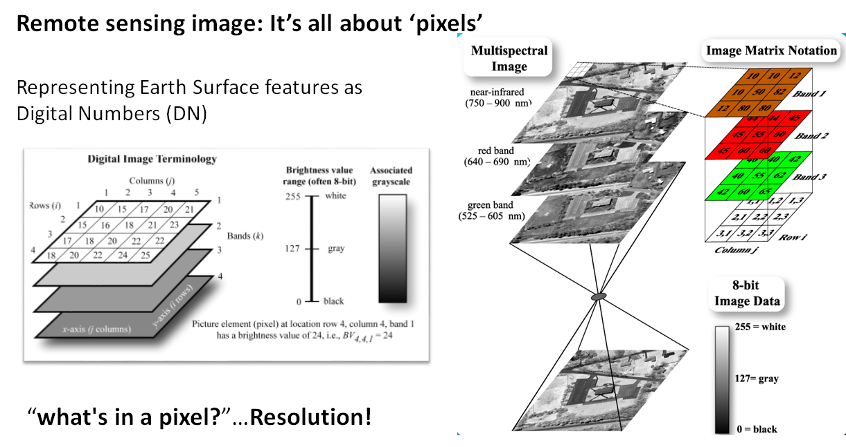
Source: Jensen 2007

Slide 21
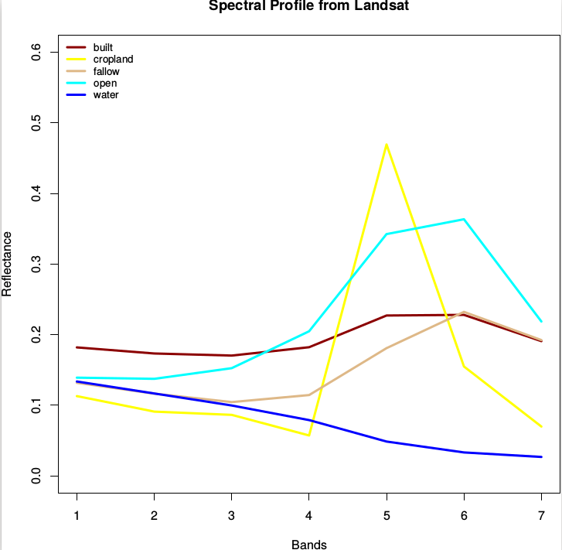
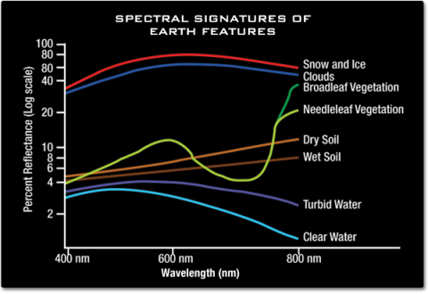
Spectral Signature
Source: NASA

Slide 22
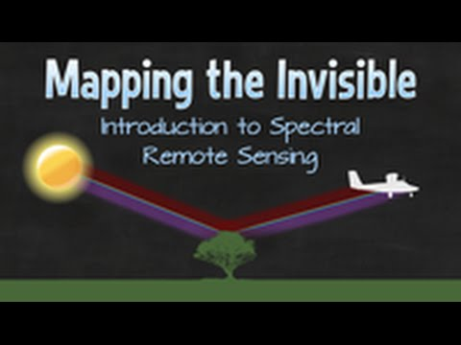
How optical sensors work
Source:
https://www.youtube.com/watch?time_continue=1&v=3iaFzafWJQE

Slide 23
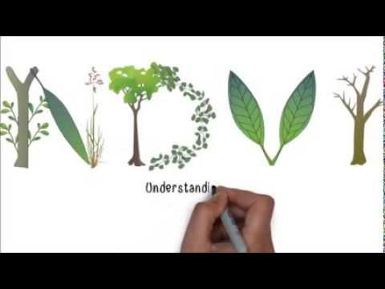
Vegetation
Indices
Source:
https://www.youtube.com/watch?time_continue=1&v=rxOMhQwApMc

Slide 24
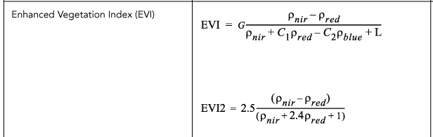
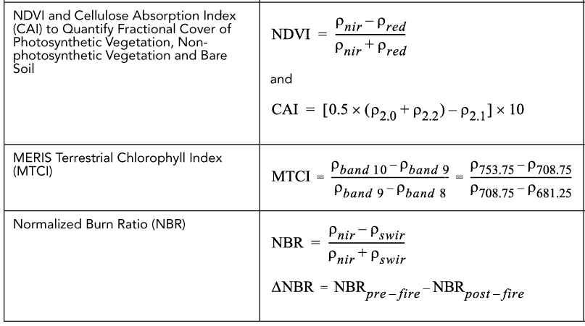
Remote sensing vegetation and other indices
There are numerous different vegetation indices enhancing different leaf properties (e.g. pigment concentration, water content)
Indices with different bands can enhance other surface features also (e.g. water, snow, built-up)
Many of them can be adapted to a selected sensor based on the available bands of sensors (wavelengths)
A detailed list can be found here: https://www.indexdatabase.de/

Slide 25
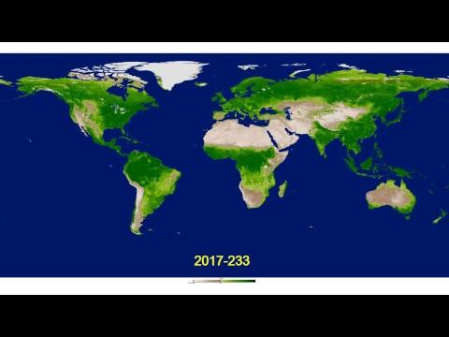
Global NDVI variation, 2017
Click on the video to see the transition

Slide 26
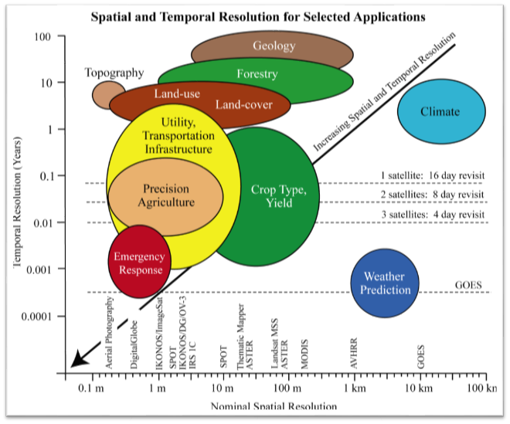
Finding the ‘best’:
Trade-off between resolution
Jensen, ERP, 2006

Slide 27
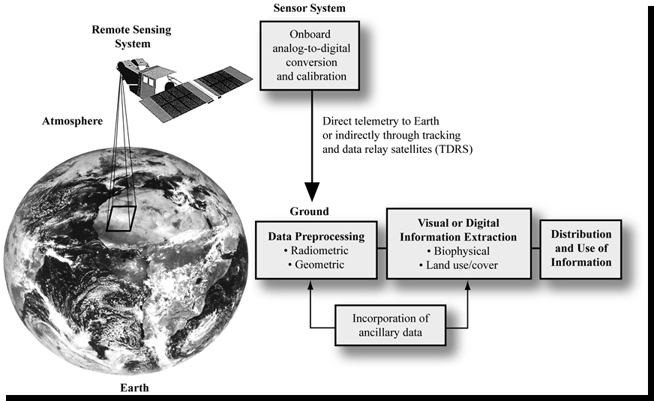
Jensen, ERP, 2006

Slide 28
Remote Sensing Image Analysis Workflow
Search and Download Image
https://earthexplorer.usgs.gov/
Visualization and Pre-processing
Mask cloud, atmospheric correction, align
Spatial prediction
Classification & Regression
Image Enhancement
Compute Indices, transformation

Slide 29
Limitations
Not a panacea that provides all the information needed to conduct physical, biological, or social science research. It provides some spatial, spectral, and temporal information of value in a manner that we hope is efficient and economical.
Remote sensing system design, calibration, data collection and processing are subjected to human method-produced error.
Sometime intrusive: active remote sensor systems (e.g., LIDAR, RADAR, SONAR) may affect the system being observed
Remote sensor data may be expensive to collect and analyze

